Slide 1
Final Project: The Battle of the Neighborhoods
Bao Ngoc Dinh

Slide 2
Data Acquisition
We need the following data:
NYC Crime data: https://data.cityofnewyork.us/Public-Safety/Citywide-Crime-Statistics/c5dk-m6ea
geojson of NYC: provided by the course
Foursquare NYC data

Slide 3
Project Description
A big city in New York can be scary. We created this file to compare NYC neighborhoods by boroughs and neighborhoods. This guide would be perfect for new people who just moved to the city and wants to know which neighborhood fits them in terms of popular venues and low crime rate.
What are some safe neighborhoods in Manhattan? Which ones aren’t?
Visualization of the neighborhoods and crime stats?

Slide 4
Crime Dataframe
Data Cleaning: drop NA, renaming columns,….
Data engineering: Reverse geocoding
Data visualization
1
2
3

Slide 5
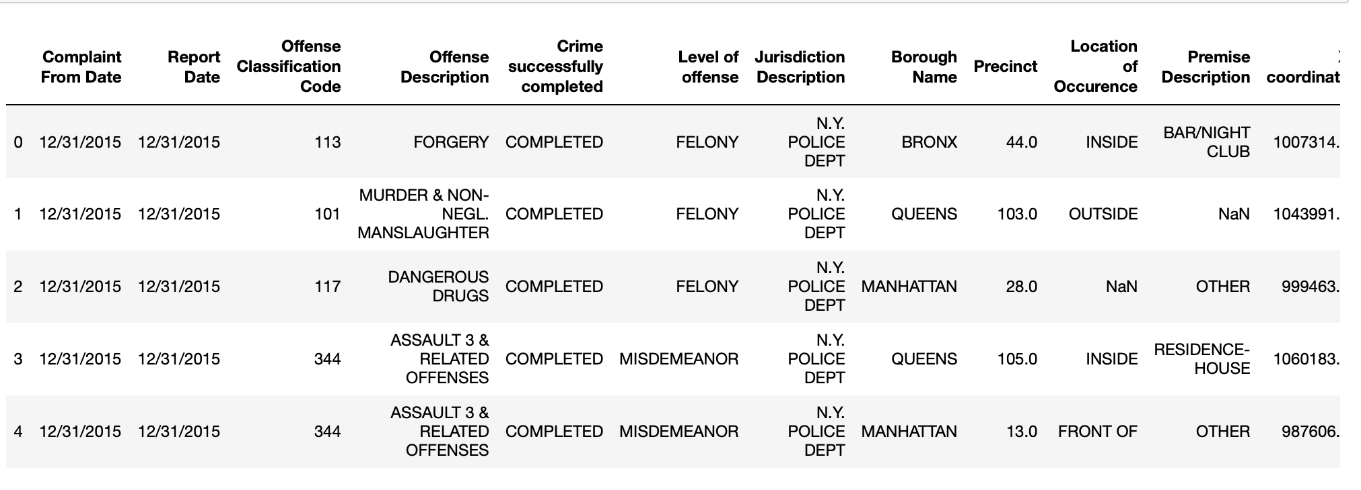
Overview of the dataframe

Slide 6
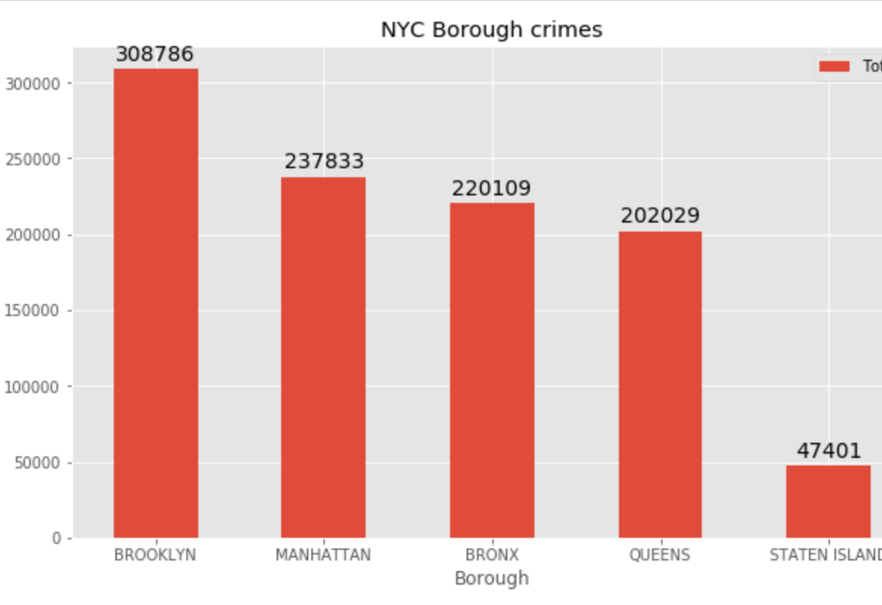
Data Visualization -1
When we look at this graph, we can see that Brooklyn has the most amount of crimes. Staten Island is much lower, almost 5 times less than Brooklyn. However, this could be misleading. Staten Island is the borough with the least amount of people, hence the decreased offense. Brooklyn is the borough with the biggest population. However, since this data is aggregate data of many years and the population number is per year, taking the total amount of offense divided by census data would not be a good indicator of crime per population.

Slide 7
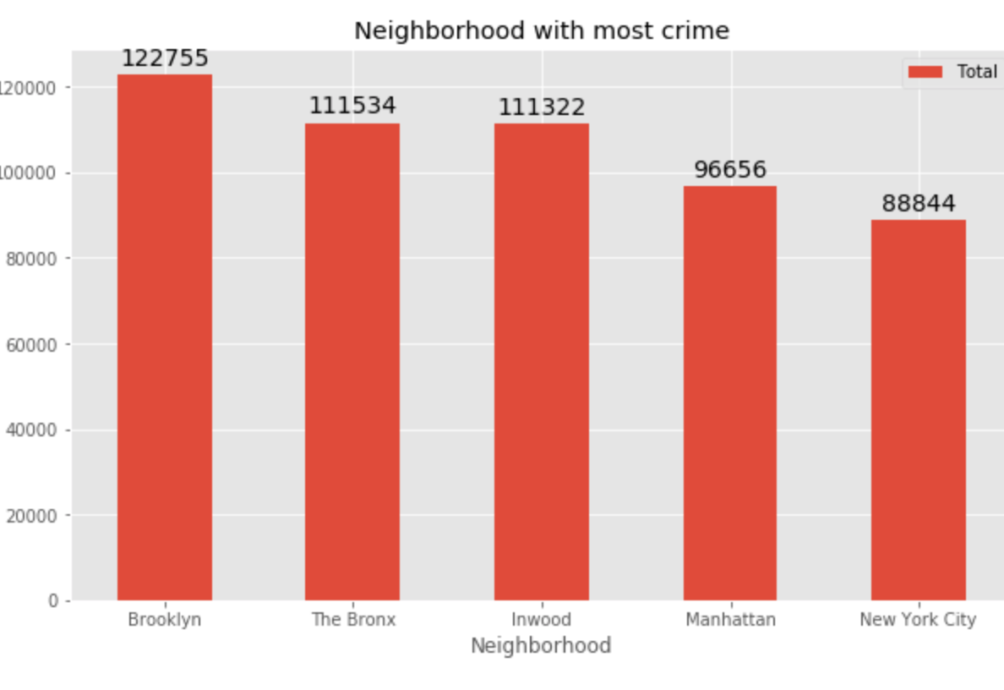
Data Visualization-2
As I said, the rg geocode is not perfect. The neighborhood division is not perfect, reflected by the two 'Manhattan' and 'New York City' category. It's confusing and misleading. Inwood is a specfic neighborhood in Upper Manhattan.

Slide 8
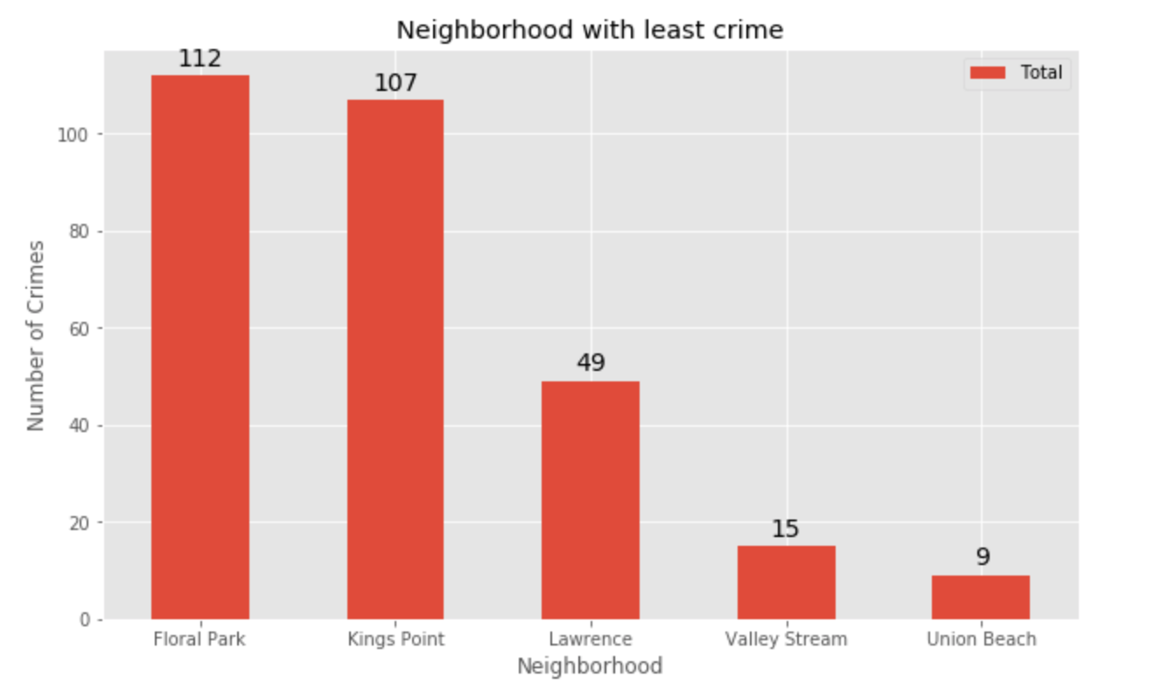
Data Visualization -3
I graphed the neighborhoods with least crime. These neighborhoods are all part of Long Island, NY. For those of you who don't live in New York the city is divided into five boroughs, and Long Island is not one of the five boroughs but it shares a border with Queens and part of NY state. Thus, many of the calls from Long Island would made it into NYC data cause of proximity. However, these neighborhoods would be considered 'bigger metro NYC area'.

Slide 9
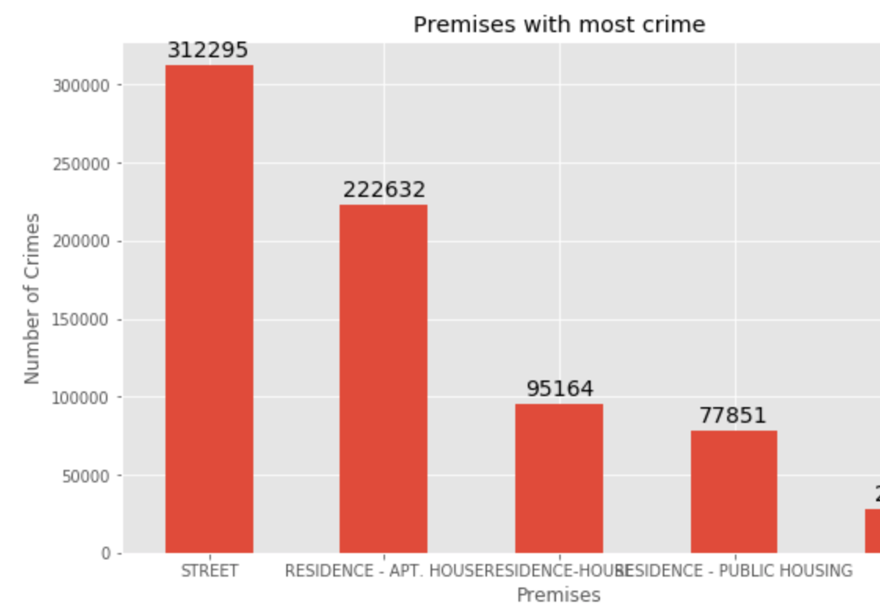
Data Visualization-4
As we can see, the offenses often takes place in an apartment or a street. However, if we want to compare this data against popular venues in NYC generated by Foursquare API, we are more interested in places such as yoga, cafe, brunch spots... so we will remove some category of places of offenses from the dataframe.

Slide 10
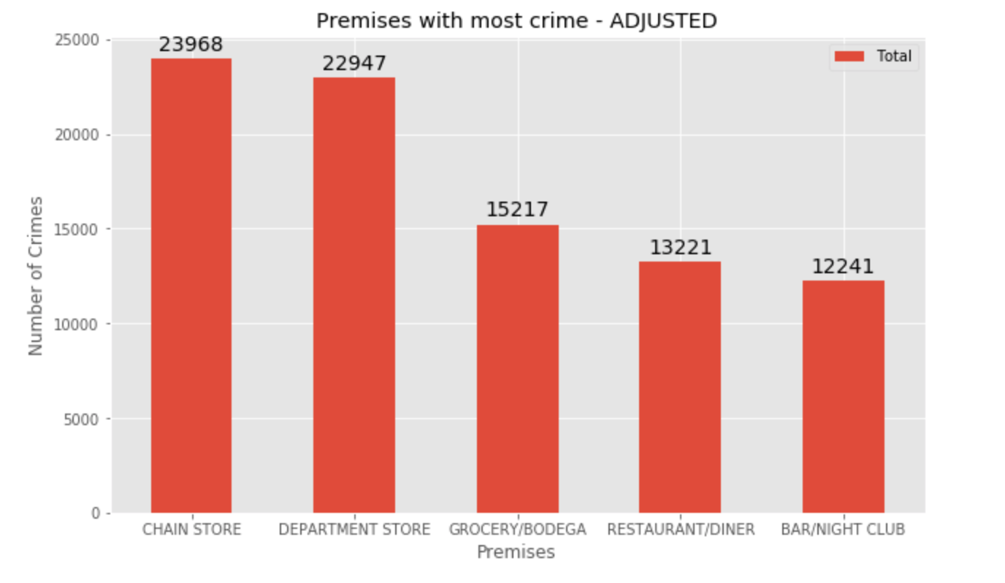
Data Visualization -5
After removing residential building and ambiguous values, we got our top 5 places with most crime occurrences in NYC. We could cross-match this against our clusters and their most popular venues.
However, Our focus will be on Manhattan since the only part of NYC clustered is Manhattan.

Slide 11
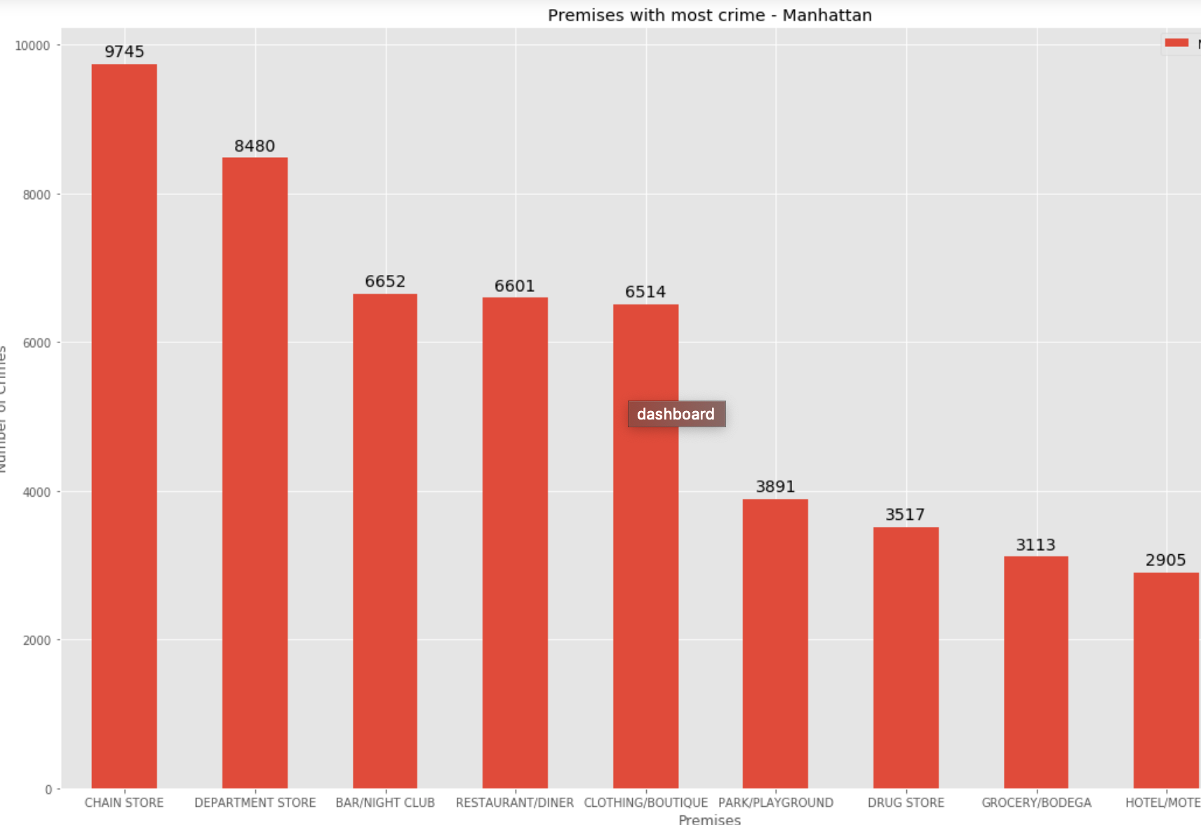
Data Visualization – 6
Since our cluster produces 10 most popular venues in the area, we are going to cross match the 10 premises with most crimes against the 10 most popular venues in the area.

Slide 12
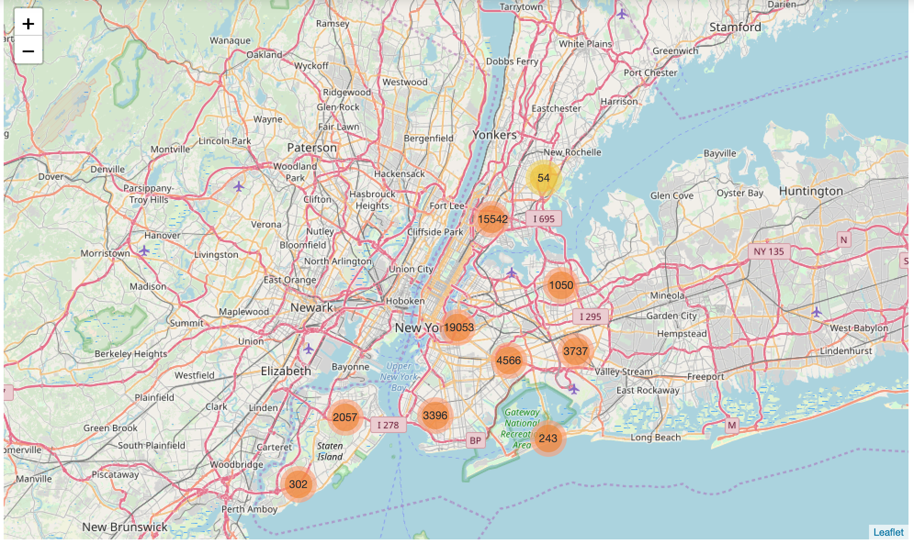
Crime Map
I created a map of NYC Crimes. the color indicates the severity of crime in the neighborhood. There are some neighborhoods that have more crimes than other. Due to my limited computing power, I only chose the first 50,000 rows. The whole dataset has at least 10x more data.
Upper Manhattan has a heavy concentration of crime, which makes sense since our bar charts indicated the same thing.
Less incidents occur in deep Queens and Staten Island, which also go with our bar chart results.

Slide 13
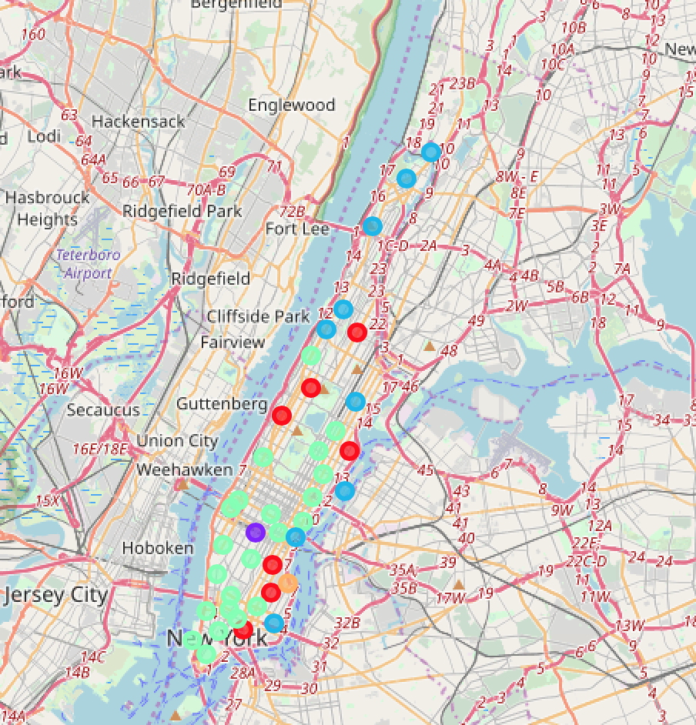
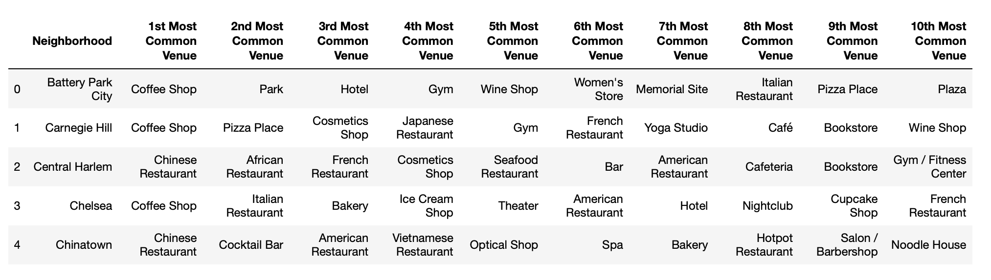
5 clusters for Manhattan based on Foursquare API

Slide 14
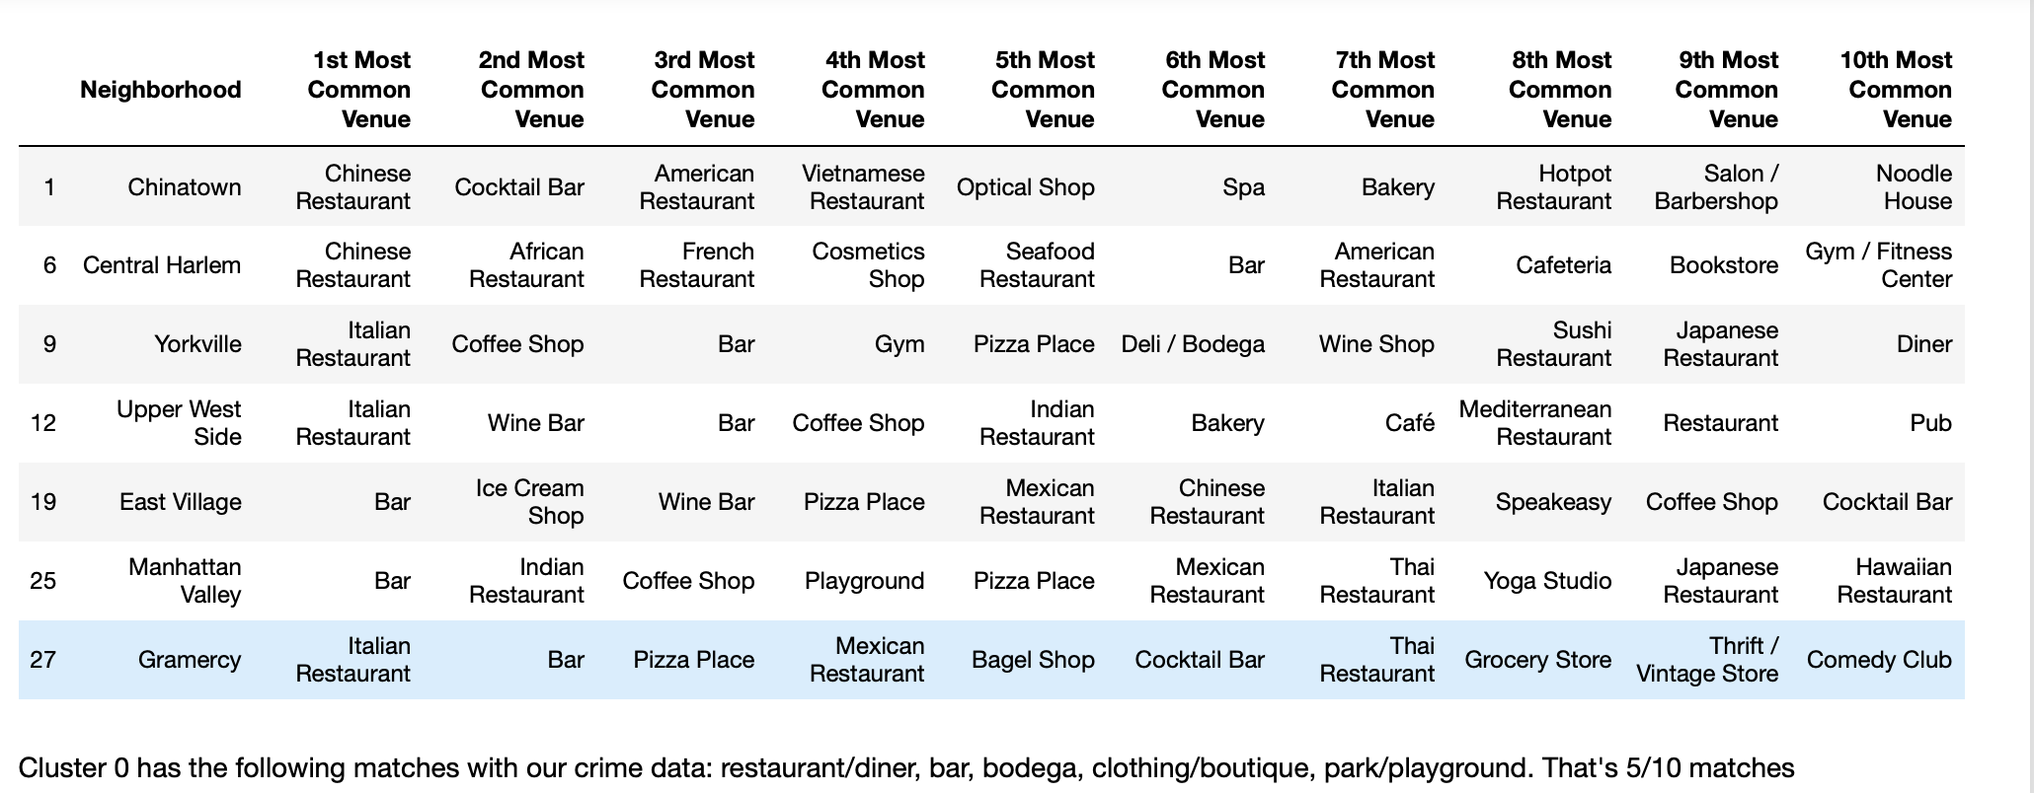
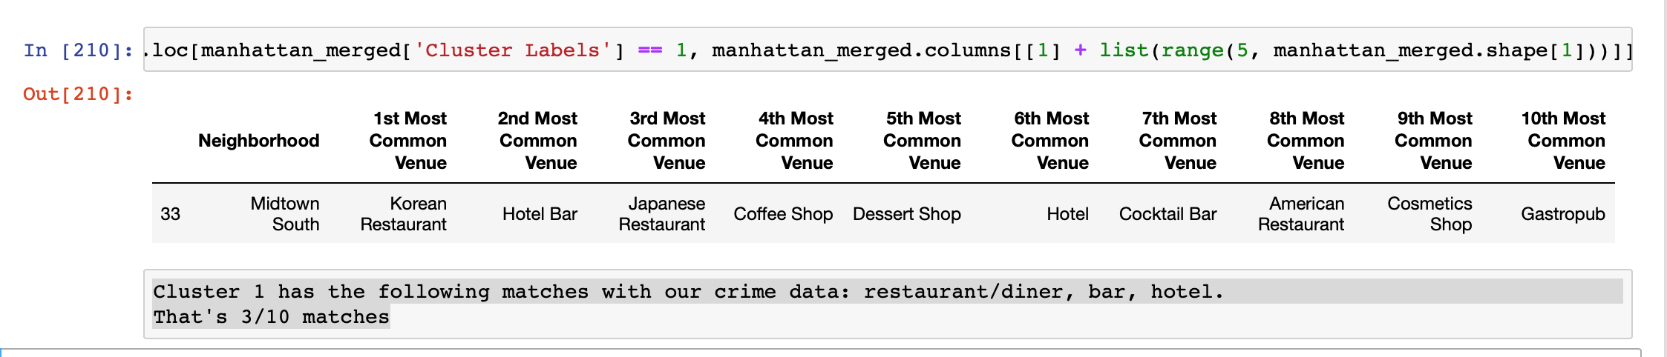
Examine Clusters and Crime

Slide 15
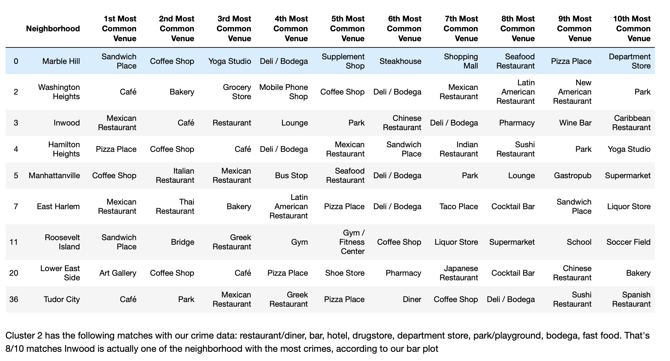
Examine Clusters and Crime-2

Slide 16
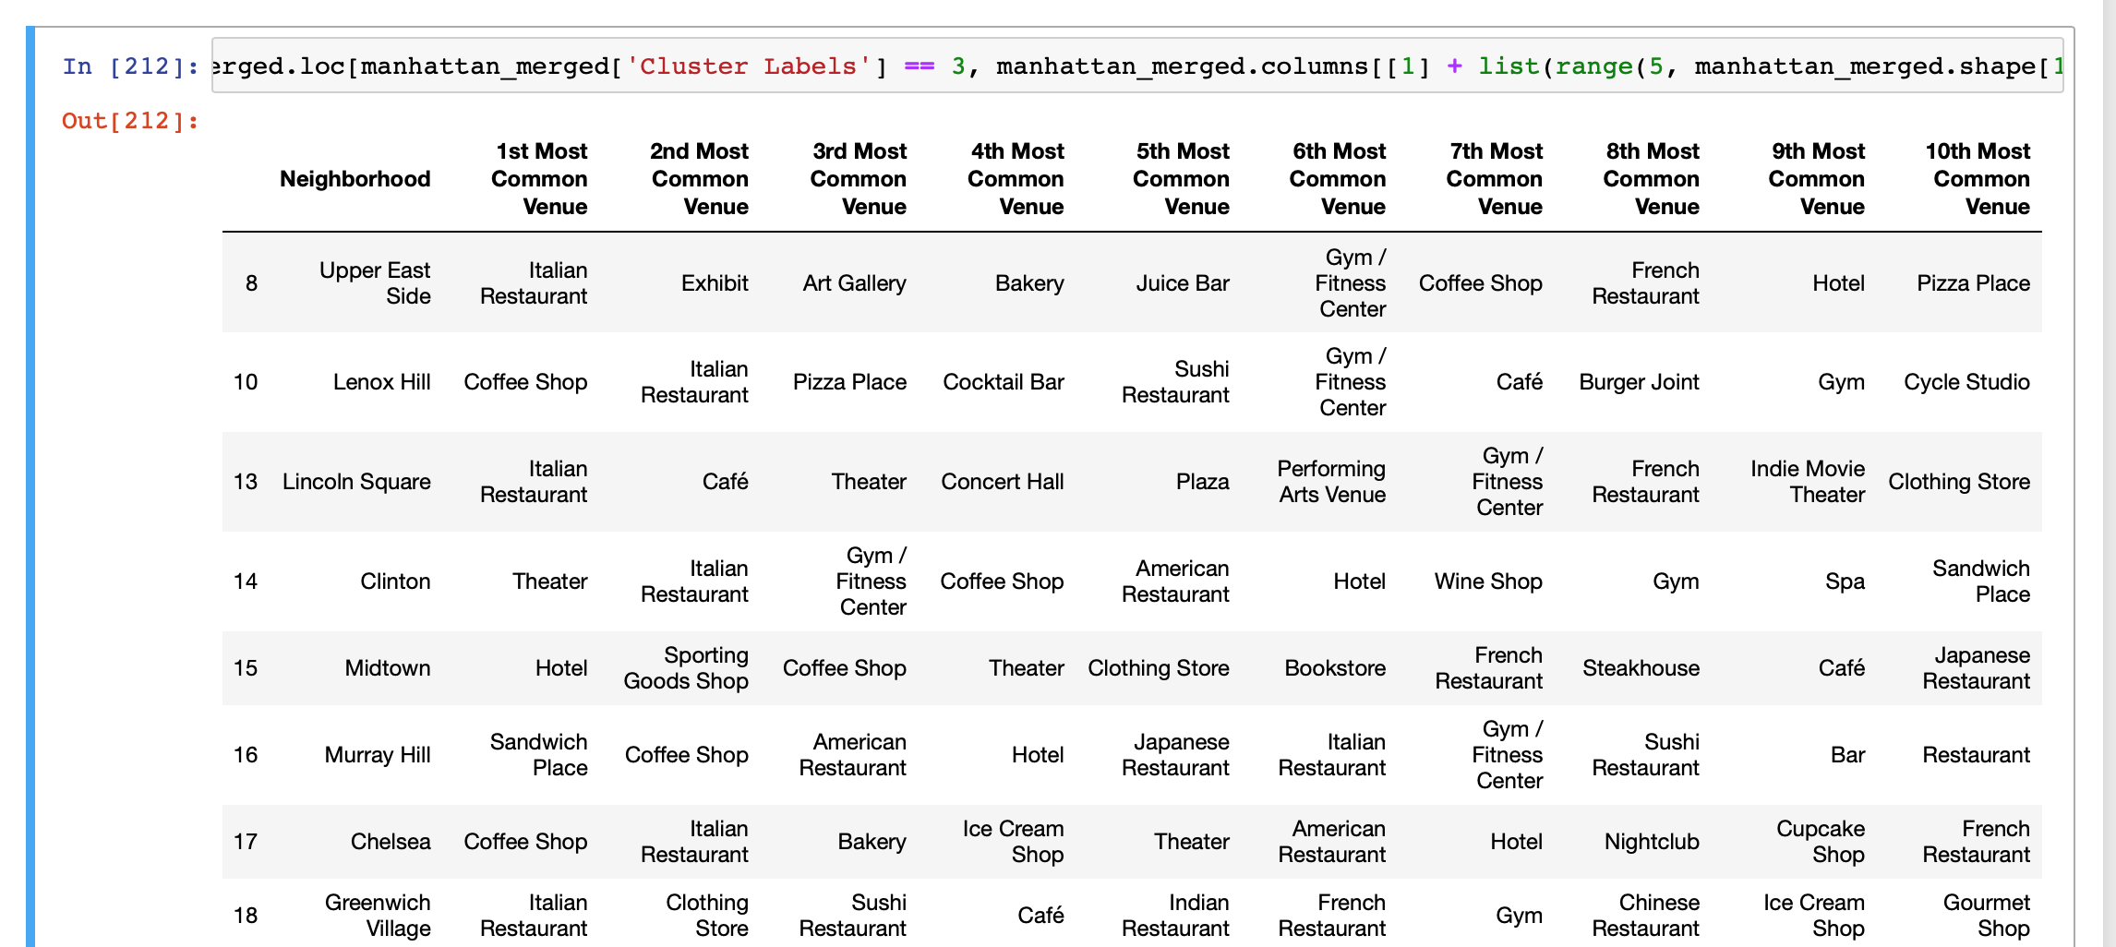
Examine Clusters and Crime-3
Cluster 3 has the following matches with our crime data: restaurant/diner, boutique, bar, hotel, drugstore, department store, park/playground, bodega, fast food.
That's 9/10 matches
However, this cluster is very wide spread and not every single neighborhood in the clusters have 9/10 matches.

Slide 17
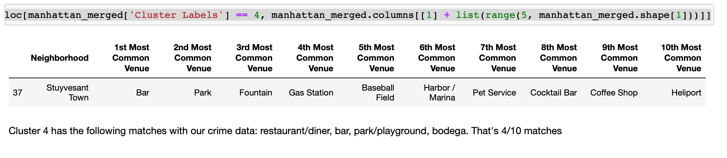
Examine Clusters and Crime-4

Slide 18
Conclusions
The dataset does have its setback. However, through this analysis I hope I can give you a guide into crime prevention in the Big Apple. Avoid neighborhoods with high crime matches, and review my crime stats visualization before you make a trip to NY
There are limitations to the dataset and the process that I, however, do hope to improve:
First of all, the reverse geocoding was not an exact match. Reverse geocoding is a costly process and to get precise neighborhood, we would need paid services such as Google API. The dataset is too big so it would be costly to run reverse geocoding. Thus, we cannot merge the crime and the cluster dataset based on neighborhood matches.
NYC's venue definitions and terms vs. Foursquare's definition and terms. NYC data refers to any sit-down restaurant loosely as restaurant while Foursquare divided it into different cuisines. Thus, the matches are not exact match.
However, there is potential for this project to scale further. I can cluster nyc neighborhoods. The only reason why I did not was because the Foursquare API and my code encountered some problems and it returned all neighborhoods as one big cluster. Thus, that would not provide any insight into the different clusters. However, we could scale this and do a borough-by-borough guide. we could also overlay the map of different neighborhoods (geojson data), and the clusters, and crime heatmap as one big choropleth map. However, this wasn't possible due to limited reverse geocoding

